Slide 1
CS-2001 Data Structures
Binary Search Tree (BST)

Slide 2
Recap: Binary Search
Recall that Binary Search works by halving the search space
If element to search is smaller than the pivot, we reduce the search space to left subarray
If element to search is larger than the pivot, we reduce the search space to right subarray

Slide 3
Binary Search Tree (BST)
Binary Search Tree (BST) is a special binary tree that works on the principle of Binary Search
The main application for this variant of binary tree is “searching”

Slide 4
Binary Search Tree (BST)
A BST is a binary tree in which each node has the following properties:
The left subtree of a node contains only nodes with keys less than the nodes key
The right subtree of a node contains only nodes with keys greater than the nodes key
Both the left and right subtrees must also be binary search trees themselves

Slide 5
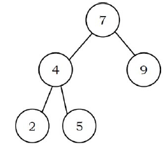
Example
A valid BST: Each node satisfies the Binary Search Tree property

Slide 6
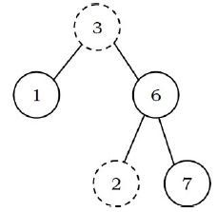
Example
Not a valid BST: Right subtree of root (3) contains a node with smaller key (2)

Slide 7
Operations
Primary operations:
Search
Find max/min element
Inserting a new node
Deleting an existing node
Secondary operations:
Finding kth smallest/largest element
Others

Slide 8
Search Operation

Slide 9
Discussion
While performing search on a BST, we are always traversing either the left or right subtree. This reduces the search space to half
If the key to search is smaller than the key at root, and no left child exist, we can terminate the search there
Same goes for right subtree, while searching a larger key

Slide 10
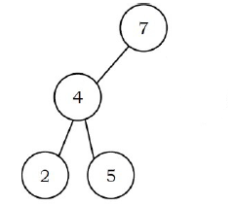
Example
Searching 28:
We can terminate search at root since no right child exists

Slide 11
Discussion
Since root data is always between left subtree data and right subtree data, performing inorder traversal on binary search tree produces a sorted list
Insertion and deletion can change height of the tree

Slide 12
Discussion
For a complete binary tree, the basic operations can take O(lg n) worst-case time
In case of skewed tree, the basic operations can take O(n) worst-case time
We will see later how to deal with skewed Binary Search Trees

Slide 13
Insertion
Insertion operation is similar to searching
We keep going to either right subtree or left subtree depending on the value and when we reach a point left or right subtree is null, we put the new node there

Slide 14
Example

Slide 15
Deletion
Deletion operation is slightly more tricky as we consider different cases
Node to be deleted has no children (leaf node)
Node to be deleted has exactly one child
Node to be deleted has exactly two children
Before going through these cases, we need to understand the terms inorder successor and predecessor

Slide 16
Inorder Successor & Predecessor
For a given node X:
If X has two children then its inorder predecessor is the maximum value in its left subtree and its inorder successor the minimum value in its right subtree
If it does not have a left child, then a node’s inorder predecessor is its first left ancestor

Slide 17
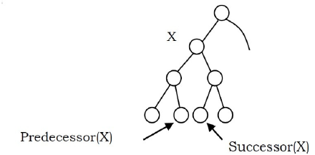
Example

Slide 18
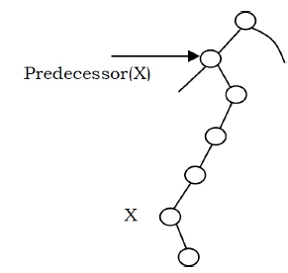
Example

Slide 19
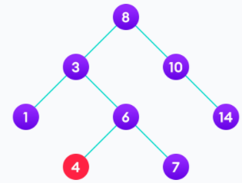
Deletion
Case 1: Node has no children (is a leaf node)
In this case, simply remove the node from the tree
Example: 4 is to be deleted

Slide 20
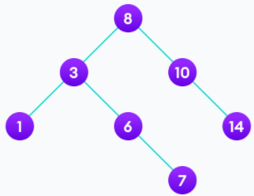
Deletion
Case 1: Node has no children (is a leaf node)
In this case, simply remove the node from the tree
Example: 4 is to be deleted

Slide 21
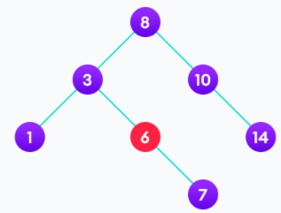
Deletion
Case 2: Node has one child
In this case, replace the node with its child node
Example: 6 is to be deleted

Slide 22
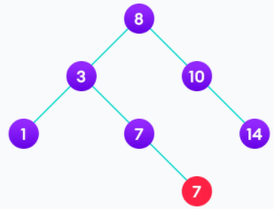
Deletion
Case 2: Node has one child
In this case, replace the node with its child node
Example: 6 is to be deleted

Slide 23
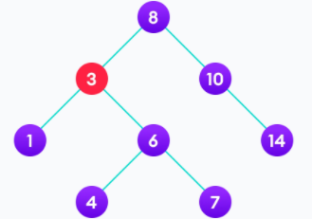
Deletion
Case 3: Node has two children
In this case, replace node with its in-order successor
Example: 3 is to be deleted

Slide 24
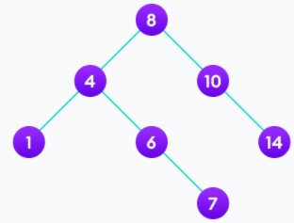
Deletion
Case 3: Node has two children
In this case, replace node with its in-order successor
Example: 3 is to be deleted

Slide 25
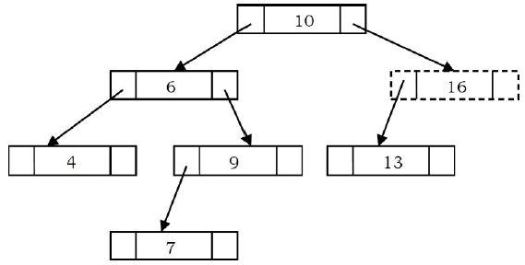
Implementation
Visualizing the node:

Slide 26
Implementation: C++
Can be found in the folder titled “Code” on Google Drive course folder

